Slide 1
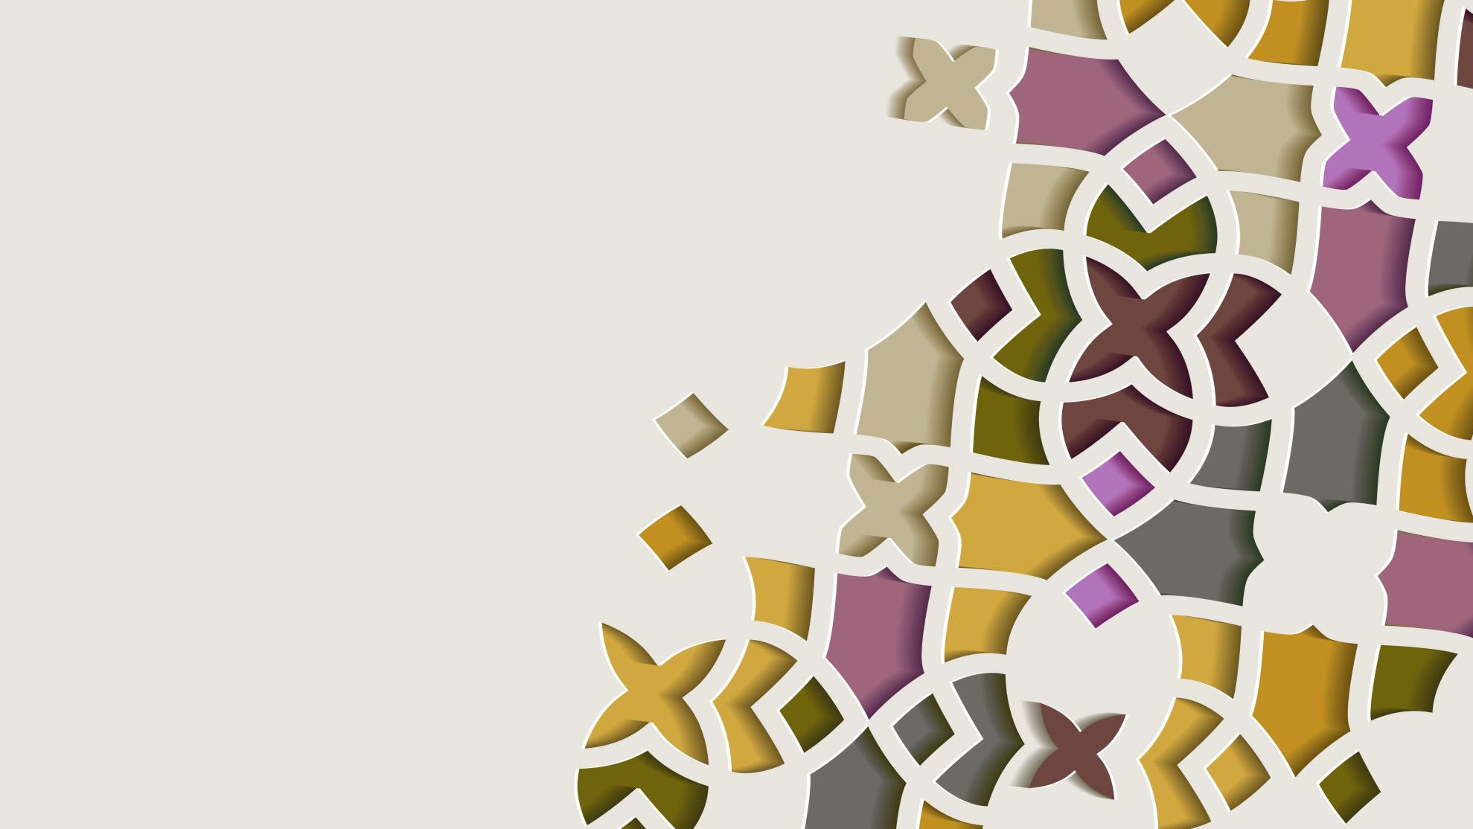
Data Challenge: Heart Failure Patient Analysis
Jasmine Wang, Fiona Lee

Slide 2



Introduction
WHAT IS HEART FAILURE?
RISK FACTORS
GOAL
Notes:
Happens when muscle is not functioning properly -> reduce stoke volume or increase heart rate

Slide 3
Data Cleaning
No outlier
No duplicate patient index
No missing values
Notes:
Outlier: checked that there are no negative values and feature ranges
Duplicate: 270 unique patient index
Missing Values: none

Slide 4
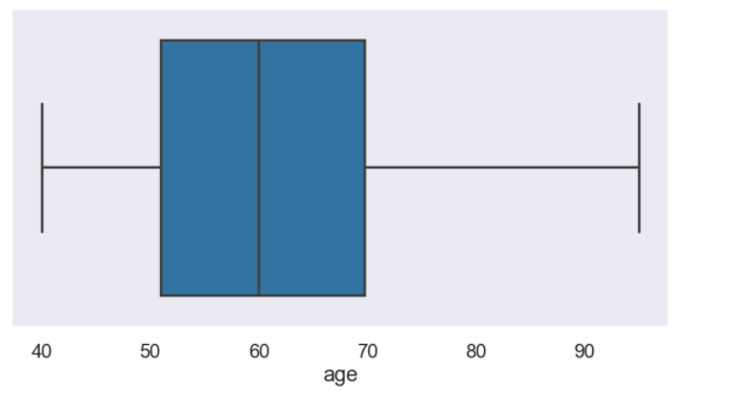
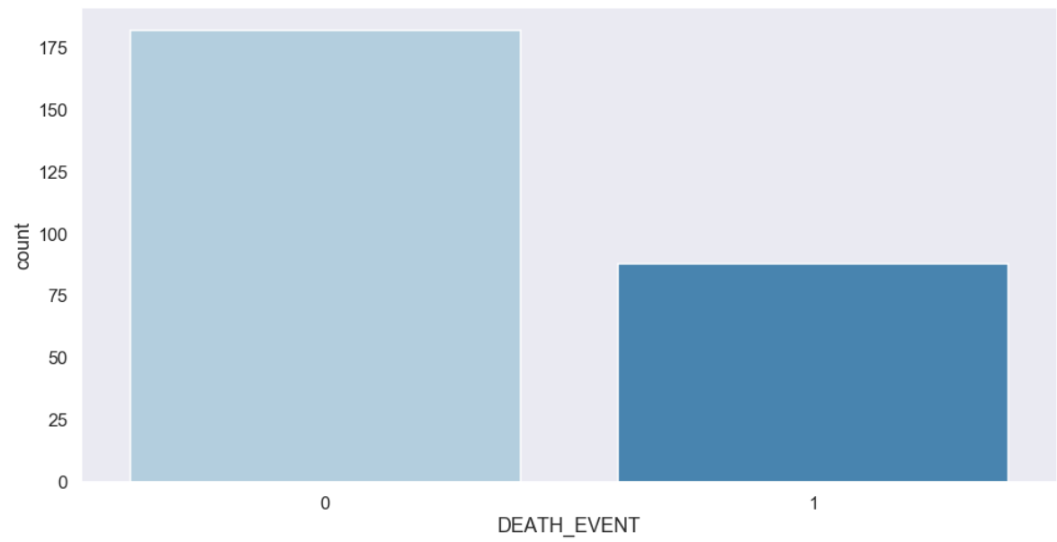
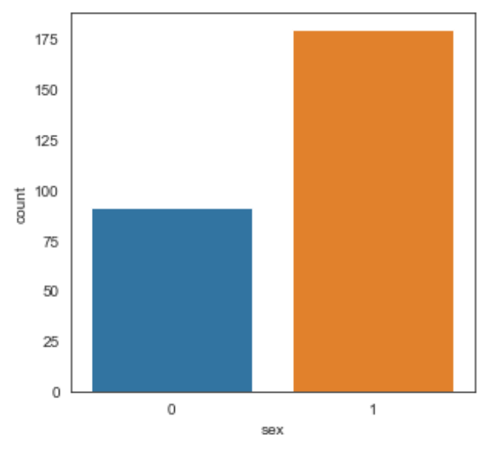
Some information about Features
Age: around 40~75 years old
Male patients: 66.3%
Death Rate: 32.6%

Slide 5
Indirect Effects (Interactions)
Direct Effects
Death Event

Slide 6
Exploratory Data Analysis Part 1
Questions:
Are there differences in features, when DEATH_EVENT = 1 and DEATH_EVENT = 0?
Are they significant?

Slide 7
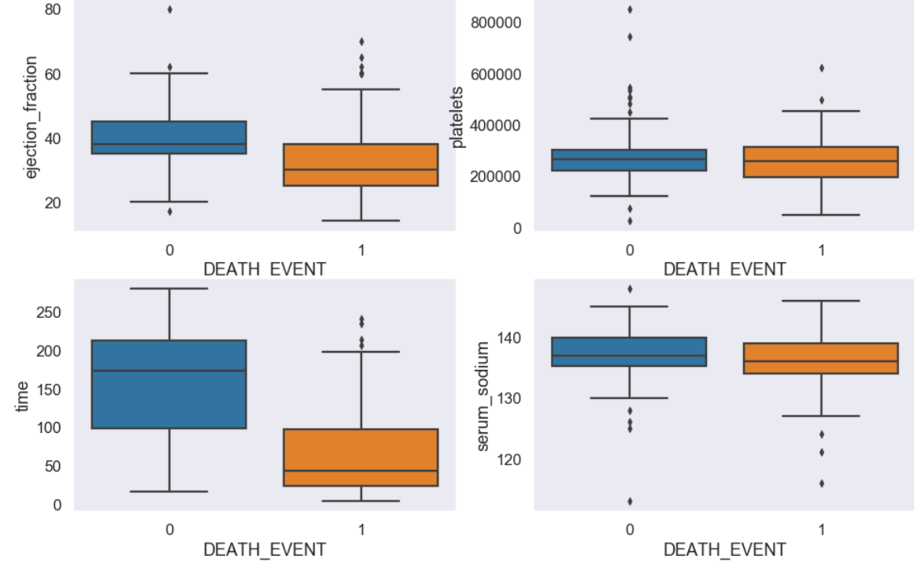
Visualizing some examples (numerical)
Notes:
We observed differences in continuous features between patients who died and patients who survived.
From the plots, we can see that variables such as time and ejection fraction has visible differences between their distributions of patients who died and patients who survived. But, variables such as platelets and serum sodium the difference is not that clear.

Slide 8
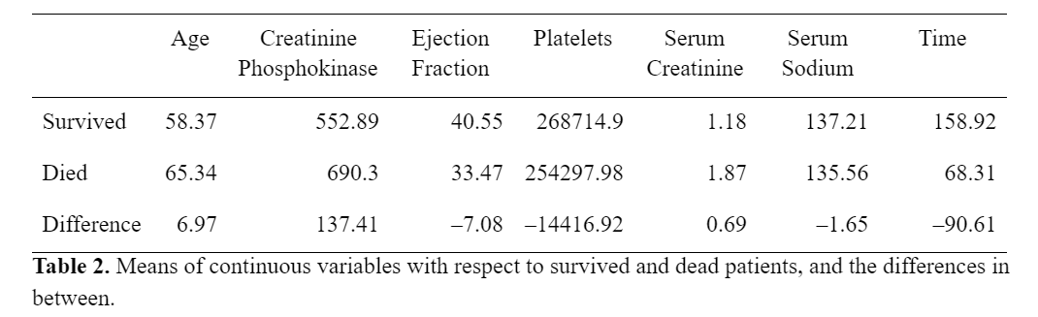
Independence of Continuous Features to Death Event
Significance test:
Mann Whitney U test
Result (p-value < 0.05):
Age, Ejection Fraction, Serum Creatinine, Serum Sodium, Time
Notes:
Observations:
People who have follow up period after 100 days tend to survive more
Normal people’s ejection fraction is around 50-70%. People who died with HF have EF much lower than those who did not die.
Older people may have higher chance of death
Procedure:
Separate each continuous features into 2 groups – patient survived and patient deceased
Do Mann Whitney U test to check if distributions of 2 groups of the same feature are significantly different.
Features with p value less than 0.05 is consider dependent to Death Event.
Possible explanations:
- diminished serum creatinine may lead to poor cardiac output.

Slide 9
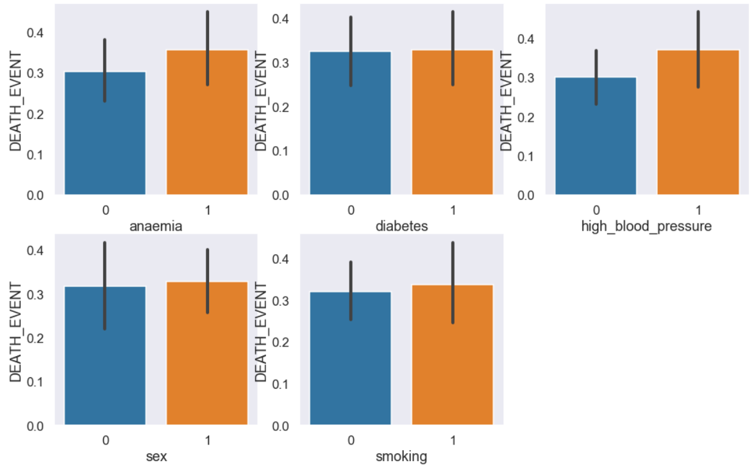
Visualizing some examples (categorical)
Notes:
We also observed differences in categorical features between patients who died and who survived.
Male patients are more likely to die from heart failure
Otherwise, when having these categorical features = 1, there is slight increase in the death event
Possible explanations:
1st point can due to the fact that 66 % of the sample is male patients
2nd these categorical features can be common comorbidities with Heart Failure

Slide 10
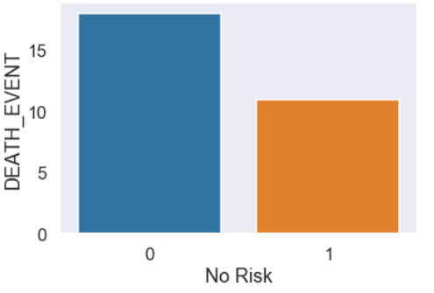
None of the disease/habits
lower death counts
Notes:
Note that people who have all categorical features except sex = 0 (= have none of the disease/habits) have lower death counts
Possible explanation:
- People who have no risk and passed away may have Heart Failure as genetic disease.

Slide 11
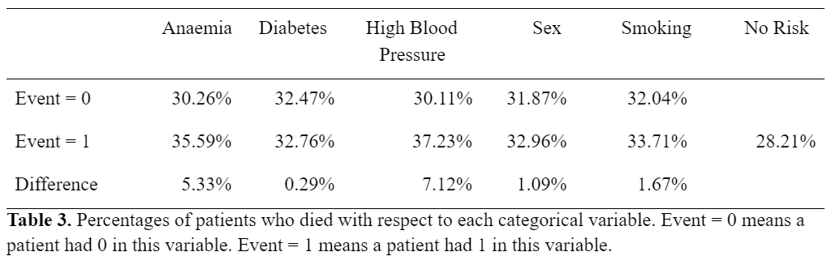
Independence of Categorical Features to Death Event
Significance test:
Chi-square test
Result:
No relationship exists (p-value > 0.05)
Notes:
These categorical features are independent to death event

Slide 12
Part 1 Conclusion
We found 5 variables that significantly correlate with DEATH_EVENT
Age
Ejection Fraction
Serum Creatinine
Serum Sodium
Time

Slide 13
Indirect Effects (Interactions)
Direct Effects
Death Event

Slide 14
Exploratory Data Analysis Part 2
Questions:
Are there any features affecting the magnitude (correlated with) these 5 variables?
Are the correlations significant?

Slide 15
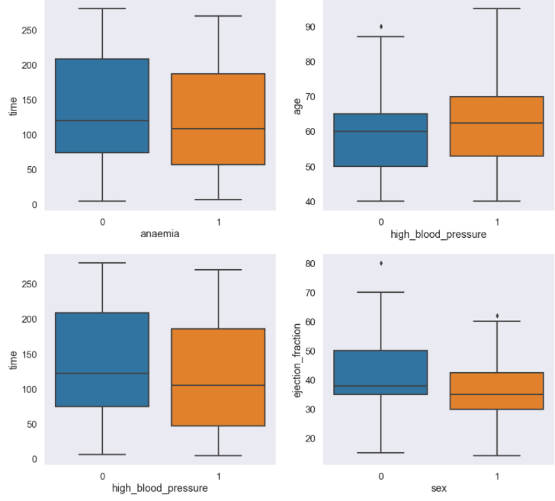
Categorical vs 5 features
Test: Mann Whitney U Test
Results (p < 0.05):
Anemia vs. Time
High Blood Pressure vs. Age
High Blood Pressure vs. Time
Sex vs. Ejection Fraction
Notes:
Separating each continuous features into two groups using one categorical variable -> see if the distributions of two groups differ
Differ means the categorical feature significantly affects the continuous variable’s value
Observations:
- ejection fraction for male is lower than female
- Having HBP can increase death rate more than other categorical variables since it affects 2 out of 5 highly correlated features

Slide 16
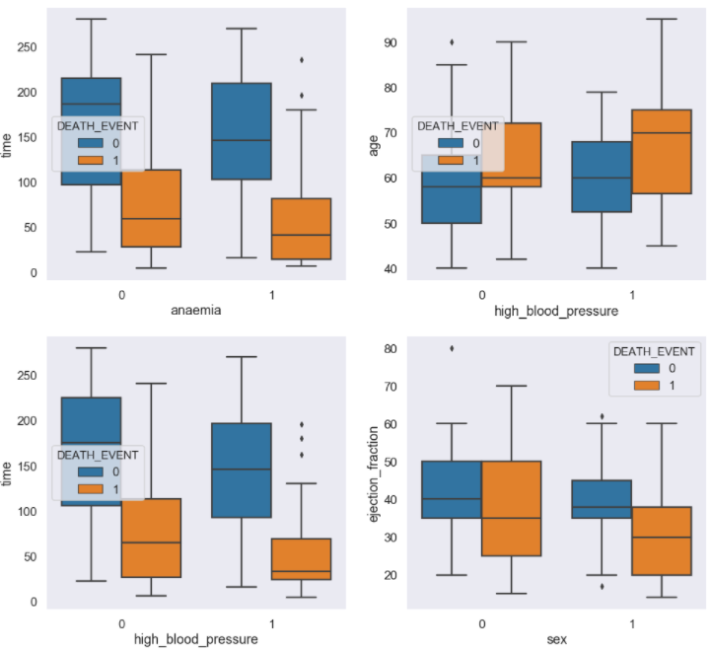
Categorical vs 5 features
How they relate to Death Event
Notes:
Last slide: ejection fraction less for males, but actually, it can be that EF is lower for male patients who died.
The median differs:
Anaemia is negatively correlated with time
High blood pressure is negatively correlated with time and positively correlated with age

Slide 17
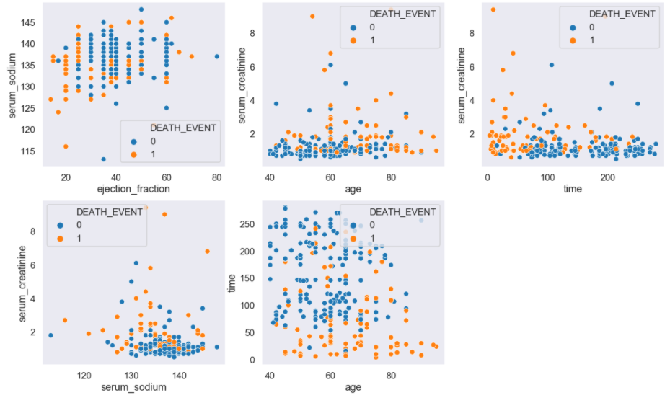
Continuous vs 5 variables
Test: Pearson correlation
Age vs. Serum Creatinine
Age vs. Time (r = - 0.22, p = 0.0002)
Ejection Fraction vs. Serum Sodium
Serum Creatinine vs. Serum Sodium
Serum Creatinine vs. Time
Notes:
The quantitative features that have significant correlation to each other is also the from one of the 5 variables vs one of the 5 variables
Note that the correlation reflects their correlation to death event, if one variable is positively corr and another is negatively corr with death_event , then the 2 variables will be negatively correlated to each other. For example, time and age.

Slide 18
Part 2 Conclusion
The Direct effects to Death Event are
Age
Ejection Fraction
Serum Creatinine
Serum Sodium
Time
There may be indirect effect caused by
Anemia
High Blood Pressure
Sex
Interaction among 5 variables
Notes:
The other variables that are not included may be because that they are indicators
creatinine phosphokinase is an enzyme produced when heart muscles fail, after circulating out of body, there may not have a long-lasting effect on other body functions.
platelets are found to be abnormal in patients with HF, but the abnormalities can be caused by either HF or comorbidities of HFs.
Categorical:
Diabetes can be well controlled when detected at an early stage, can be an explanation to why diabetes is not correlated with HF.

Slide 19


Modeling
Feature Selection
Build Random Forest Model

Slide 20
Fit Model (all features)
 | Predicted : Death Event = 0 | Predicted: Death Event = 1
Actual : Death Event = 0 | 35 | 3
Actual: Death Event = 1 | 7 | 9
Accuracy: 81.5%
False Positive: 7
False Negative: 3

Slide 21




Feature Selection
AGE
EJECTION FRACTION
SERUM CREATININE
TIME
Notes:
Using Scikitlearn Random Forest Classifier and Select from models to select feature.
One different variable from what we found in EDA. Reason may due to small sample size.

Slide 22
Fit Model (selected features)
 | Predicted : Death Event = 0 | Predicted: Death Event = 1
Actual : Death Event = 0 | 35 | 3
Actual: Death Event = 1 | 4 | 12
Accuracy: 87.04%
False Positive: 4
False Negative: 3
Notes:
False Positive number is lowered

Slide 23

Further Improvement
More sample
More features
Cause of Death
Family History of Heart Failure
Regular measurements taken
Model problem in future
Follow up period (Time)
Notes:
Sample size can be larger for better prediction
Add other features
such as regular measurements
Family history of HF
Frequency of smoking (As we know smoking contributes to clotting in the blood vessel, therefore is a great risk factor of HF. But this data doesn’t show. And this may be b/c a patient quit smoking after measurements taken or b/c they smoke only on special occasions. Also, there may be patients who live with people who smoke, and that could increase chance of getting HF too.)
the most correlated variable is Time. But if this model will be used in a clinical setting, so that the prediction can help doctors apply appropriate treatment to the patient, then time is not a factor that can help at the moment these measurements are taken.

